Slide 1
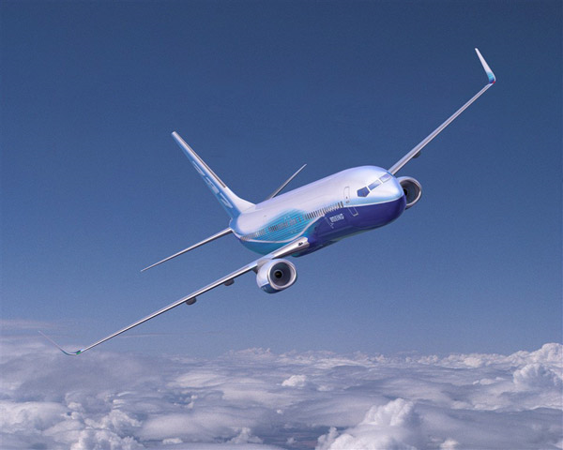
Flying into the Future: A Simulation on Boarding Airplanes
Matt D Burch

Slide 2
The Problem
Increase in jet fuel price
Airlines need to combat the cost
Cutting flights
Charging for checked bags
Fuller planes + more carry-on luggage
Increased boarding time

Slide 3
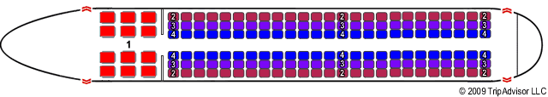
The Boeing Company
PEDS (Passenger Enplane/Deplane Simulation)
Boeing 757 (215 passengers)
Interior Configuration
Variations in passengers
Video Recorded boarding process
Outside-in policy

Slide 4
Ghent University
132 passengers
Interviews and Observation
Airplane turn time 30 to 60 minutes
Triangular distribution
Carry-on luggage causes the most congestion
Bin occupancy model
Tested 46 policies
By-seat policy the best

Slide 5
Ferrari and Nagel
Deterministic process
Disturbances
Seat interference
Different aircraft dimensions
Early/late passengers
Occupancy
By-seat and outside-in policy the best

Slide 6
Arizona State University
Interference Model
Seat interferences
Aisle interferences
Videotaped aircraft boarding
Outside-in policy the best

Slide 7
Summary of Previous Research
Which boarding policy minimizes the amount of time to board an airplane?

Slide 8
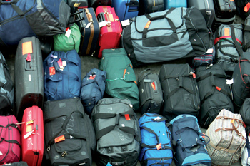
Goals
Expose other issues in boarding airplanes
Baggage policy
Design a simulation that could allow airlines to:
Analyze any baggage policy
Find a baggage policy conducive to minimizing boarding time

Slide 9
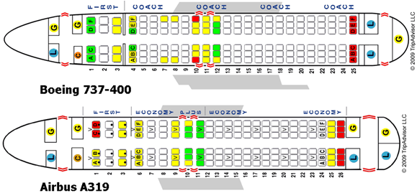
Aircraft
Short to medium ranged aircrafts (110-150 passengers)
120 passengers
20 rows
One door in the front

Slide 10
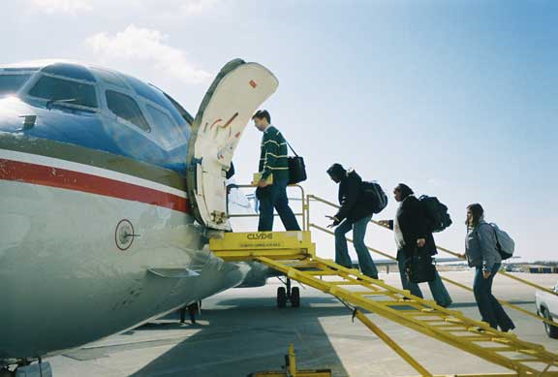
Boarding Policy
Boarding Policy
Random
Call-off system
Random/one group

Slide 11
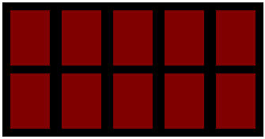

Overhead Bin
60 inches wide
Spans two rows
9.5 cubic feet
Can fit 5 bags of 47.5 linear inches

Slide 12
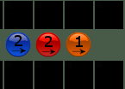
Passengers
Color
Arrow
Number of bags
1, 2, or 3 bags
Move at same speed
Bag # | Min Value | Max Value
1 | 5 | 8
2 | 2 | 4
3 | 1 | 3

Slide 13
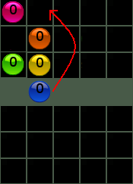
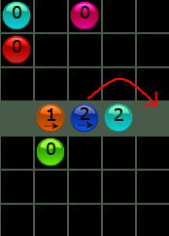
Passenger Movement
Seat Interference
When seated passengers blocks another passenger’s seat
Aisle interference
A passenger storing luggage blocks other passengers

Slide 14
Storing Luggage
Bin Occupancy
As the bin fills up, it takes a passenger longer to store a bag
Multiple bags = longer store time
Tries to store all luggage
No space in the bin
No method to backtrack the passenger

Slide 15
Testing
750 simulations
5 baggage policies
0/100/0
20/60/20
60/30/10
50/50/0
100/0/0
3 occupancy rates
100%
80%
60%

Slide 16
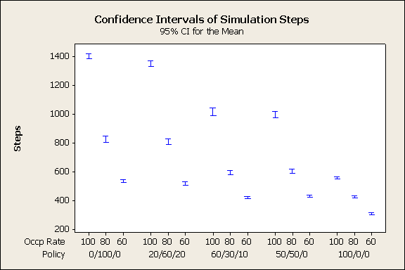
Simulation Steps

Slide 17
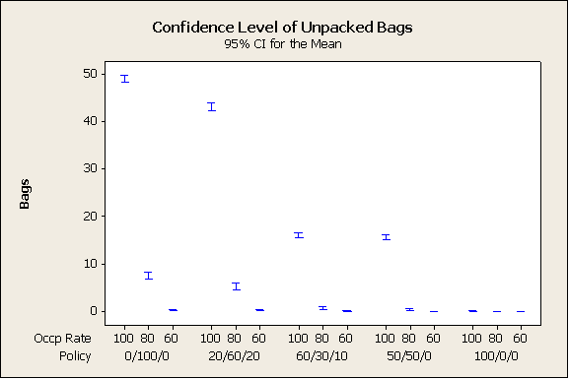
Unpacked Bags

Slide 18
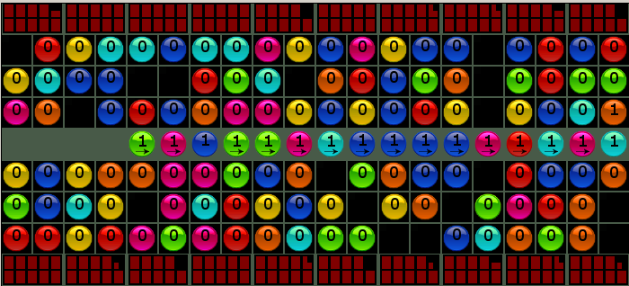
Queuing Effect

Slide 19
Suggestions
Analyze effects of policy changes
Analyze financial situation
Change baggage policy if there is consistently:
Fuller flights
People bringing more carry-on luggage
Restrict one bag being placed in the overhead
Hard to enforce

Slide 20
Strengths
Tests the effects of
Baggage policy
Occupancy Rate
Holds all other variables at constant
Allows a user to test any baggage policy
Visual representation of the boarding process

Slide 21
Weaknesses
Human behavior is hard to control
Time for tasks to complete are arbitrary
Assumes a passenger tries to store all luggage in the overhead bin

Slide 22
Extensions
More realistic human behavior
Add boarding policies
Different groups
Different bin types/bin sizes
Different size of bags
Let the user change the largest size bag a person can bring on the plane
Let people bring on no luggage
Different planes

Slide 23
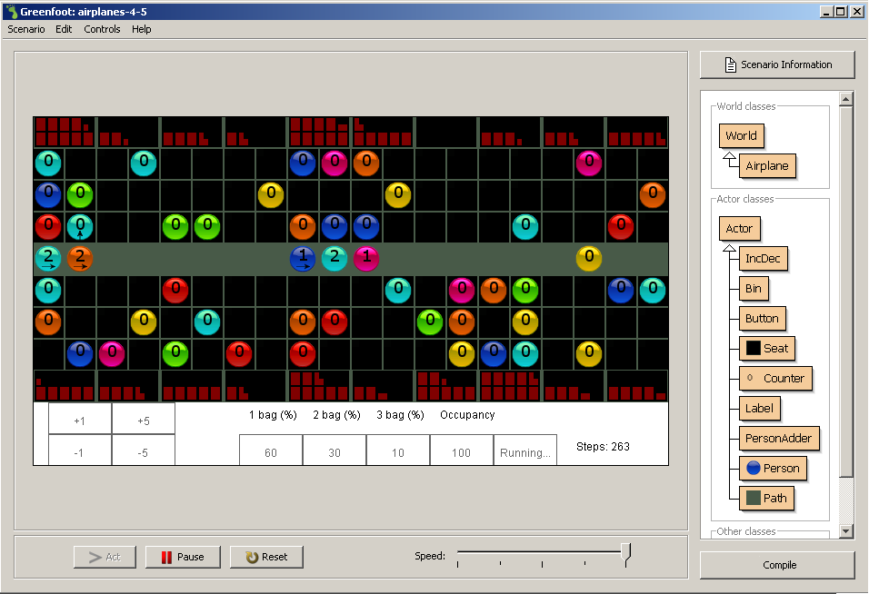
Demonstration

Slide 24
Image Sources
http://www.boeing.com/companyoffices/gallery/images/commercial/737700-11.html
http://www.seatguru.com/articles/boarding_procedures.php#Outside-In
http://media.monstersandcritics.com/articles2/1421677/article_images/baggage.jpg
http://www.marquette.edu/band/Join.html

